Slide 1

Weather Station
By #CodeSaints

Slide 2
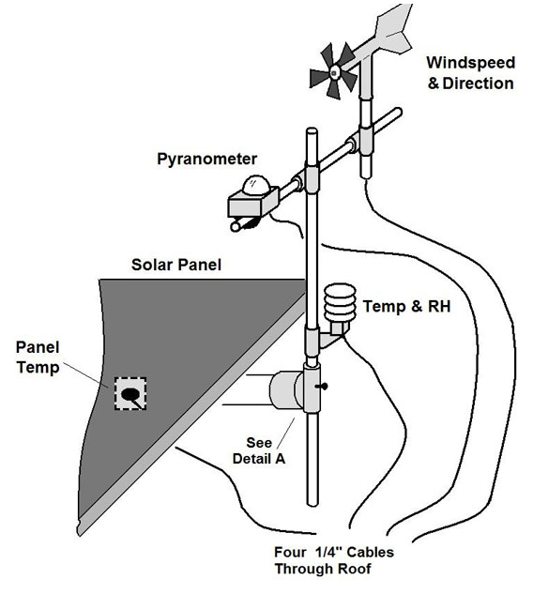
Functional Requirements
Monitor Twitter for tweets @stmguidance using the hashtag #weather
When weather tweet detected, check weather sensors and tweet the current conditions, along with a photo of King Square, at the requestor
example

Slide 3

Example Use Case
From @crimeprophet:
Hey @stmguidance! What’s the #weather?
From @stmguidance:
@crimeprophet current conditions are: temp 5°C, pressure 1002 hPa, humidity 100%, wind NNW at 3.0 km/h #CodeSaints

Slide 4
Future Enhancements
Detect luminosity
Smarter responses – e.g., don’t forget umbrella
Time-lapse photos

Slide 5
Non-Functional Requirements
Weather proof
Secure from hackers
Responsive
Availability - power
Updatable - remotely accessible
Python

